Slide 1
Non-Federal Match

Slide 2
Non-Federal Match
1303.4 Federal financial assistance, non-federal match, and waiver requirements.
In accordance with section 640(b) of the Act, federal financial assistance to a grantee will not exceed 80 percent of the approved total program costs. A grantee must contribute 20 percent as non-federal match each budget period. The responsible HHS official may approve a waiver of all or a portion of the non-federal match requirement on the basis of the grantee’s written application submitted for the budget period and any supporting evidence the responsible HHS official requires. In deciding whether to grant a waiver, the responsible HHS official will consider the circumstances specified at section 640(b) of the Act and whether the grantee has made a reasonable effort to comply with the non-federal match requirement.

Slide 3
Non-Federal Match
In-kind donations include:
Any non-cash donation, including loaned or volunteers
Meetings held in donated spaces
Government or college interns
Corporations or municipalities that donate supplies for projects
Landlords who donate space or discount rent

Slide 4
Non-Federal Match
Documenting In-Kind Contributions
Documenting in-kind contributions is a key part of a grantee’s fiscal operations. By accurately documenting in-kind expenditures, your program has a record of its financial "sweat equity" for potential funders. Sweat equity is a contribution to a project in the form of time and effort, as opposed to paying others to perform the same task.
Ensure that non-federal match efforts support the goals and objectives of the program and grant.
Create an efficient financial management system that maintains individual accounts for both federal and grantee shares.
Treat the receipt and documentation of non-federal match as you do any other significant or important transaction in the program.
Make efforts to generate specific donations of time, space, and goods for which the program has identified needs.
Address these efforts in the annual planning process and treat non-federal match as any other cost of doing business.
Develop a list of rates to be used for volunteer services based upon current prevailing rates for that service.
Determine the value of in-kind contributions such as services, material, equipment, building, and land. Decide the appropriate value of goods or services.
Remember to consider what the cost would be if the goods or services were not donated and needed to be purchased.
Give the donor a signed receipt that includes the donor's name and signature, date of donation, description of the item or service, and the estimated value.
Keep a copy of the donor's receipt for the official grantee files.

Slide 5
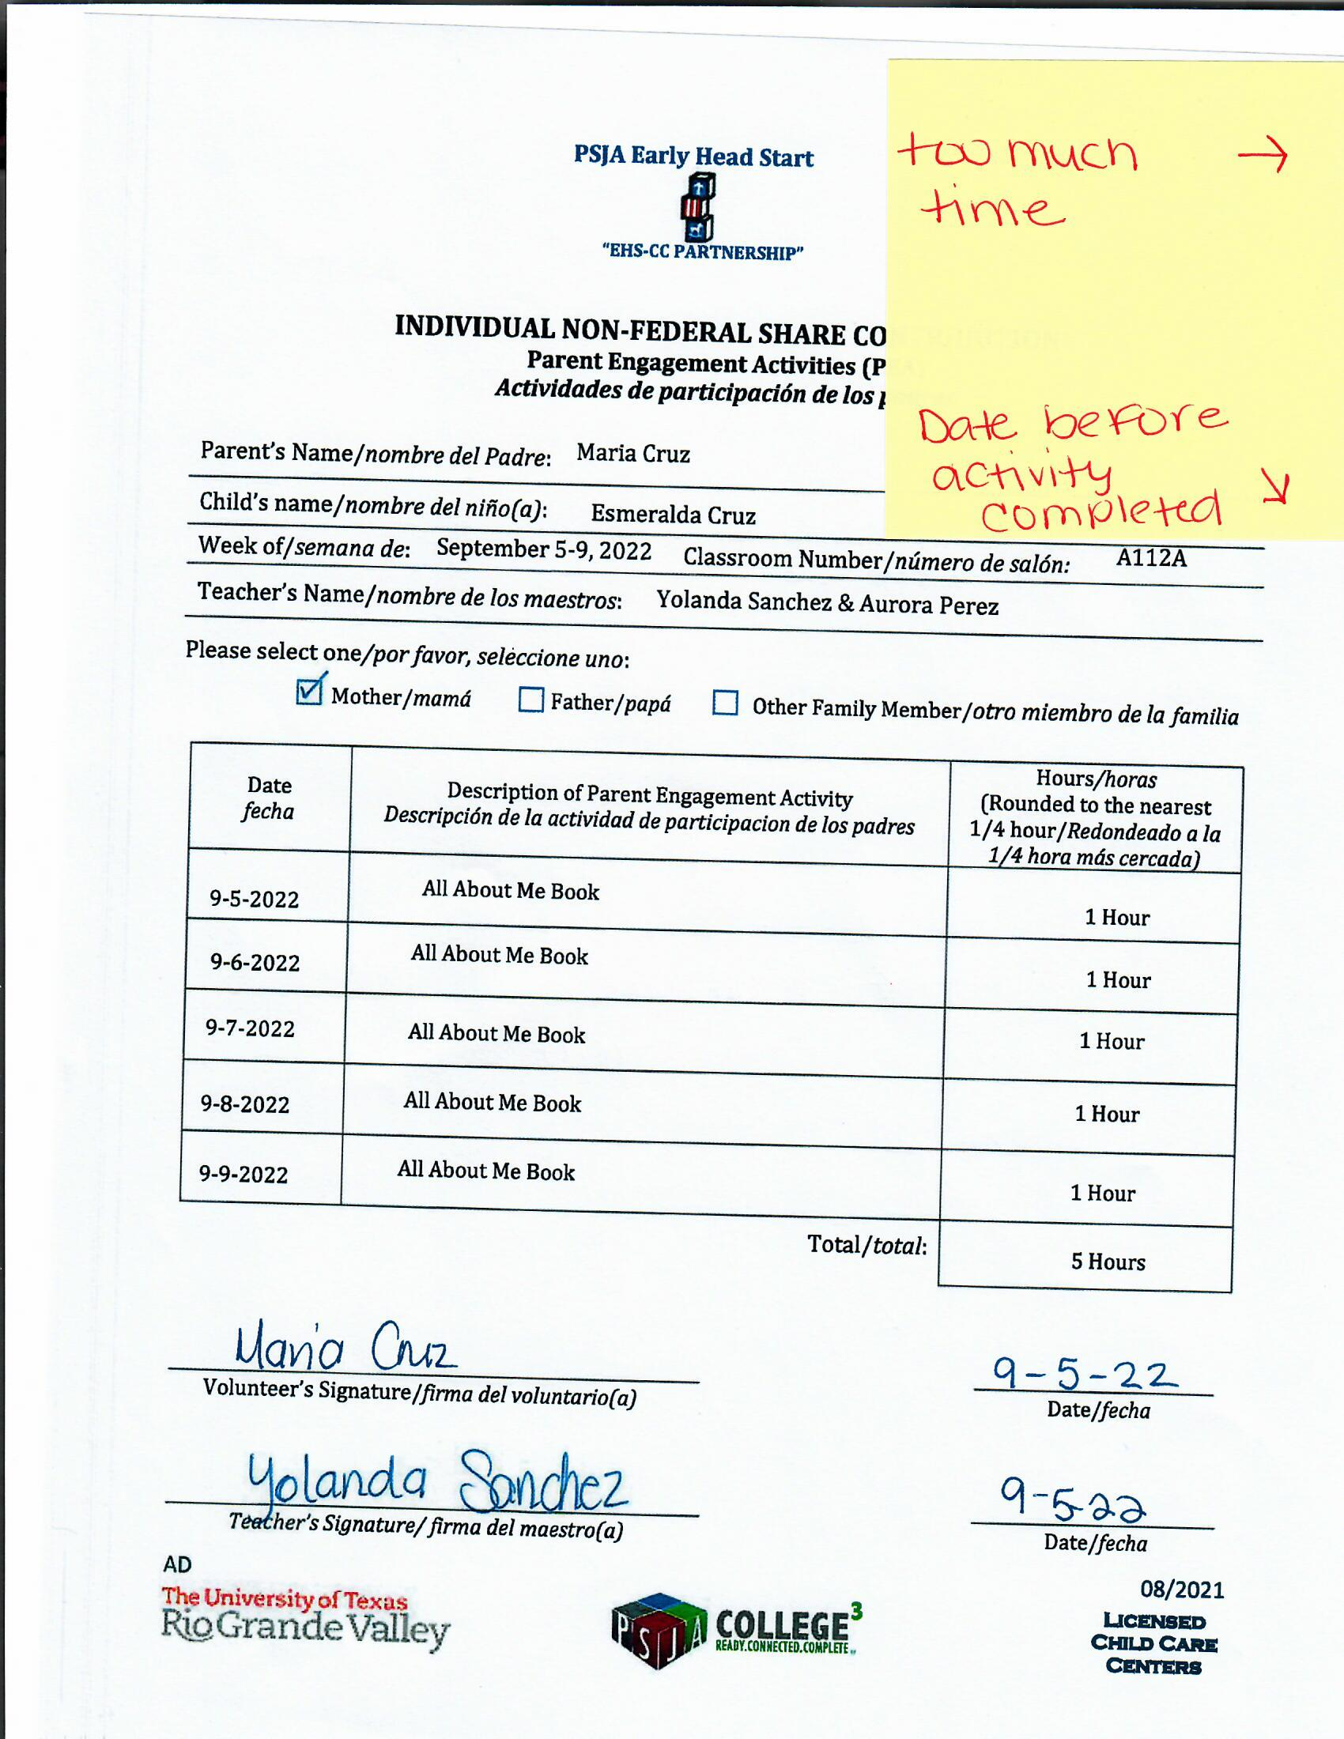
Non-Federal Match

Slide 6
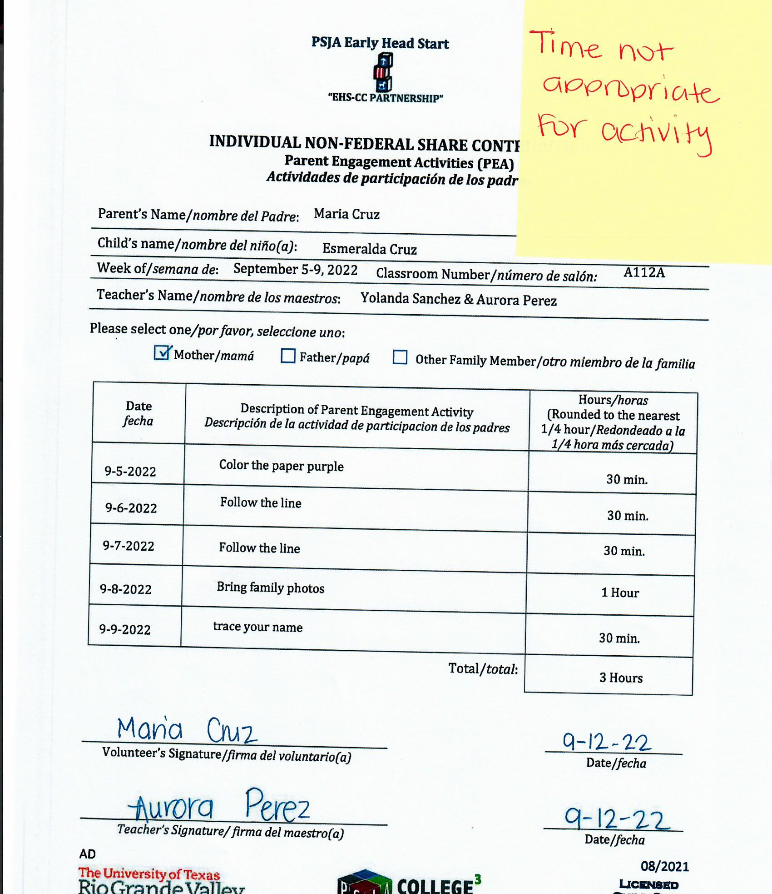
Non-Federal Match

Slide 7
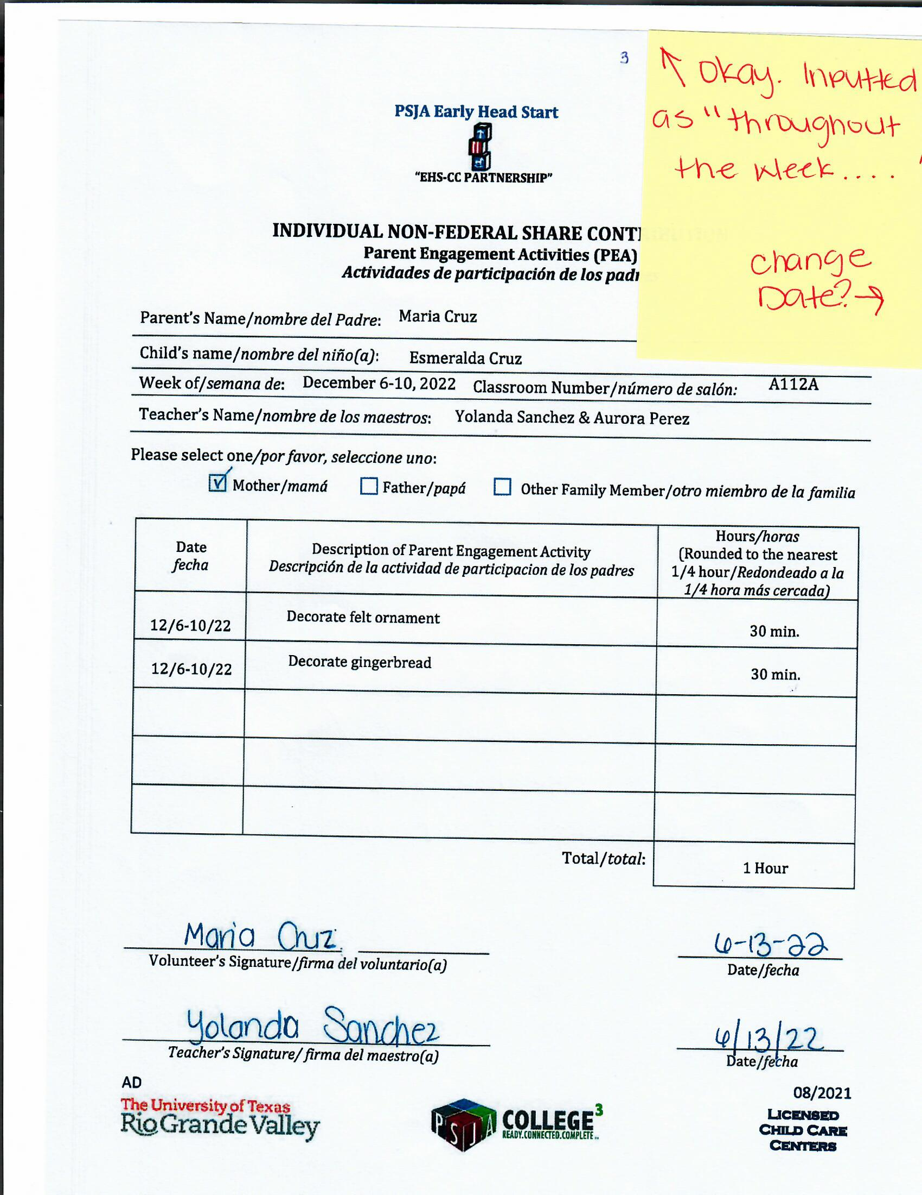
Non-Federal Match

Slide 8
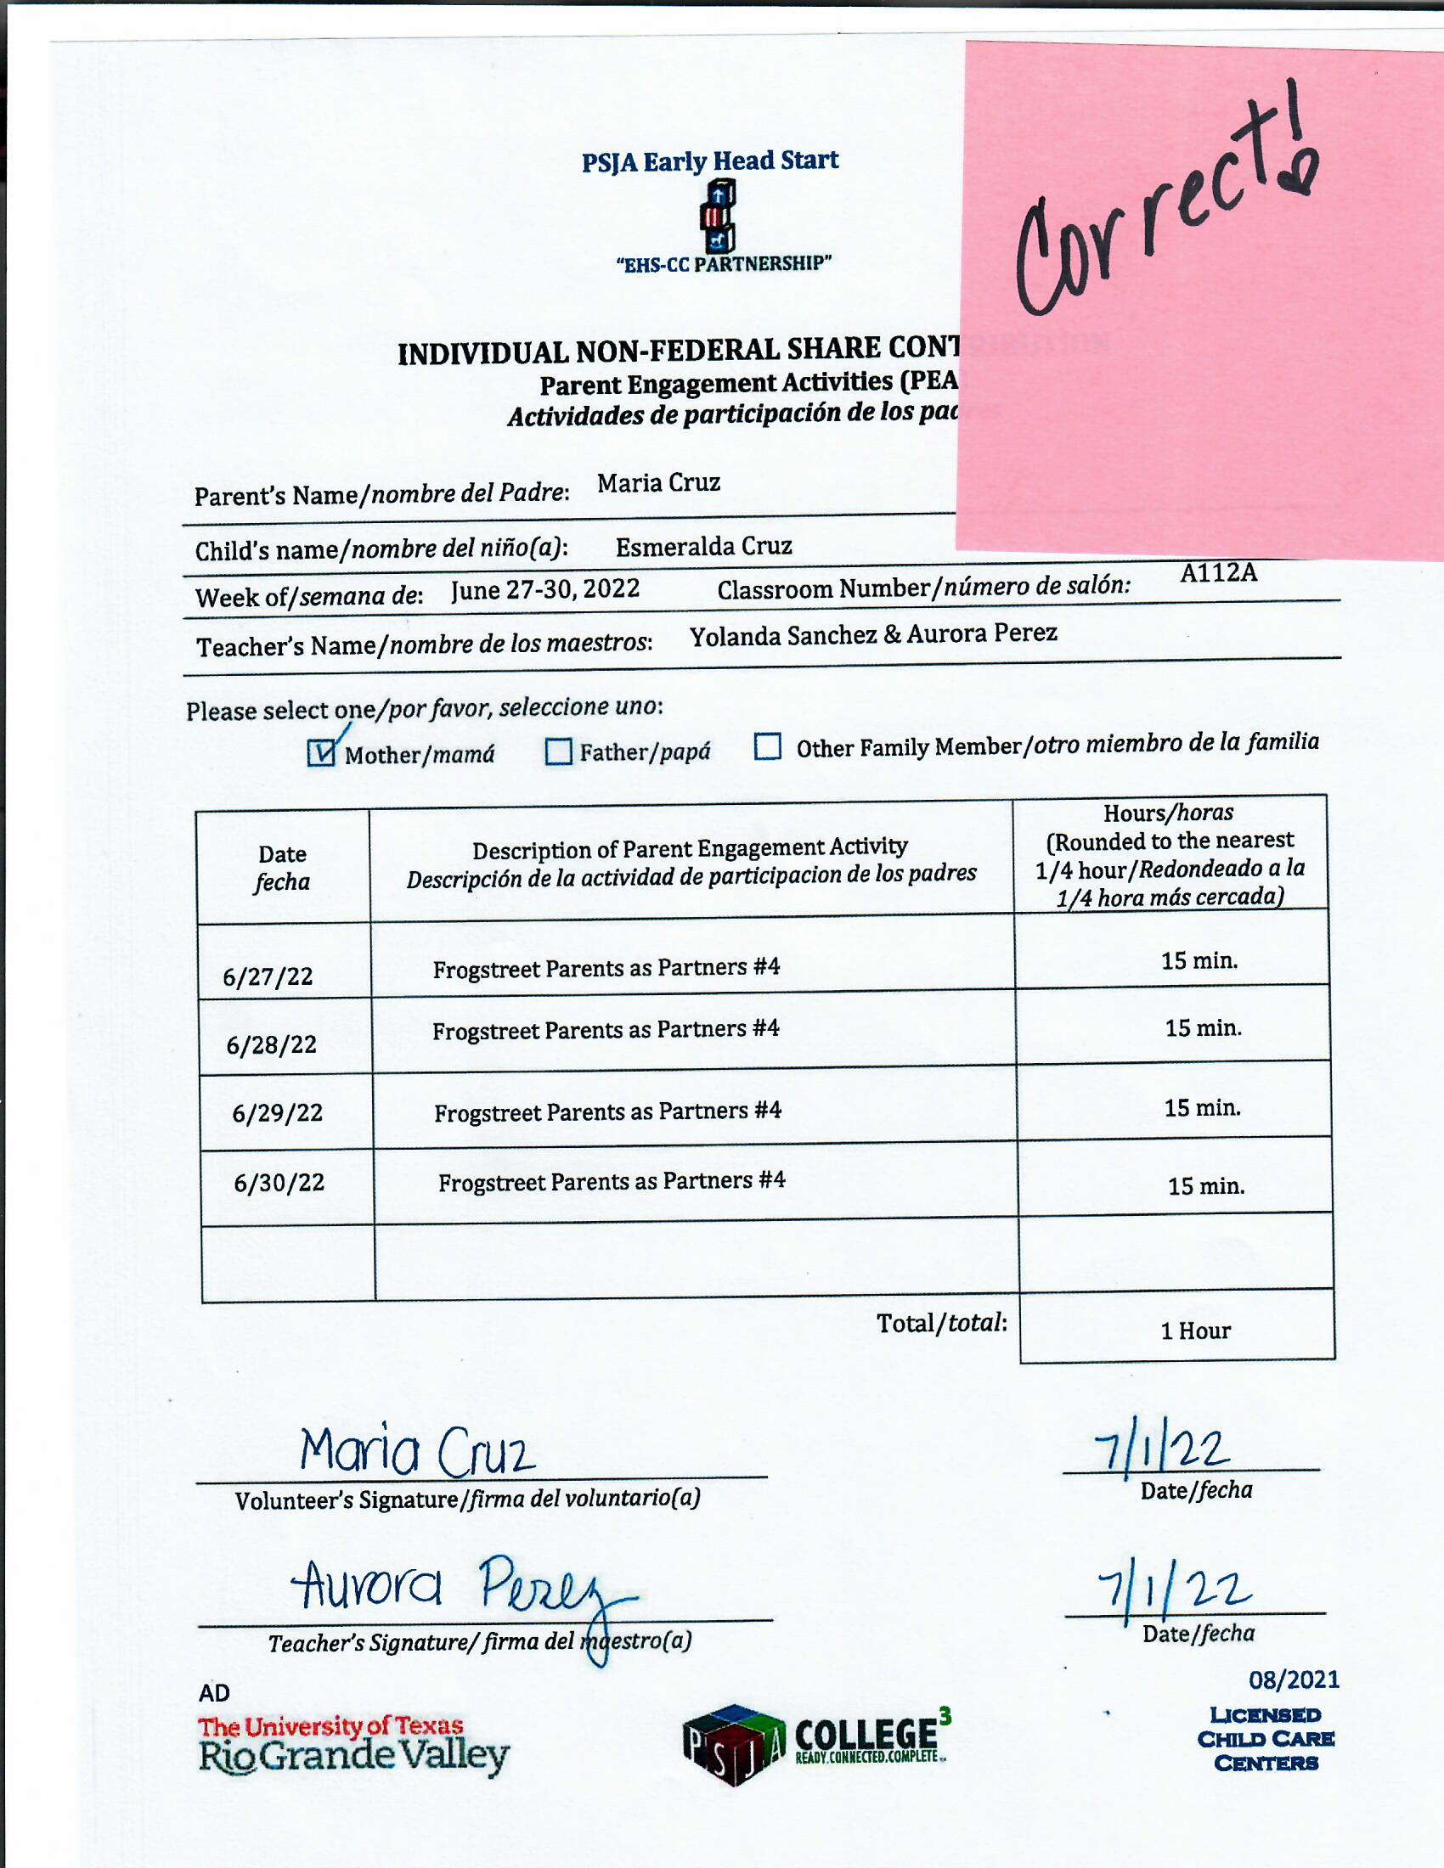
Non-Federal Match

